Slide 1


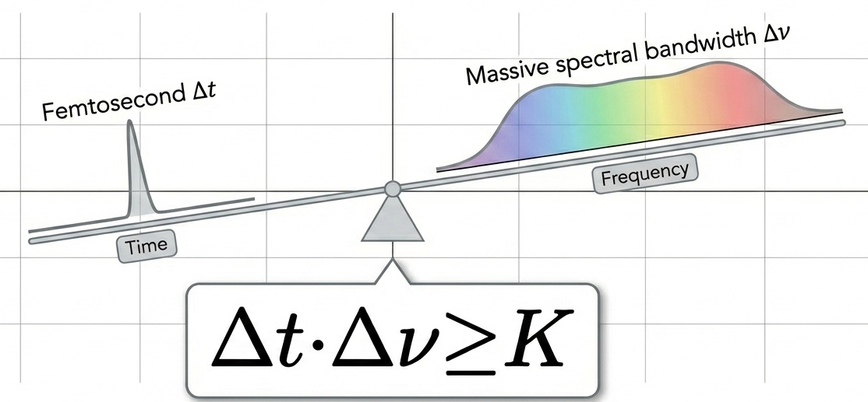
Freezing Time and Slicing Space
Ultrafast Laser For Bioimagine
陈信均 何衍宁
2026.4.21

Slide 2

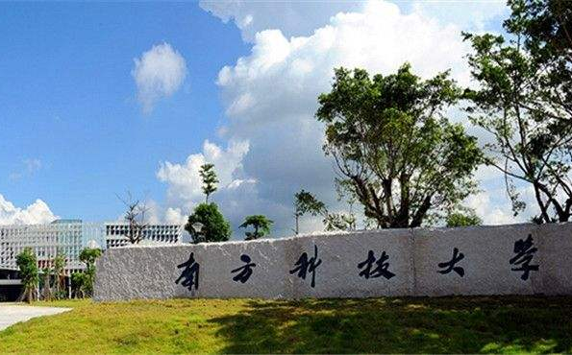
Content
Background
Temporal Resolution
Spatial Resolution
Conclusions
1
2
3
4
2

Slide 3
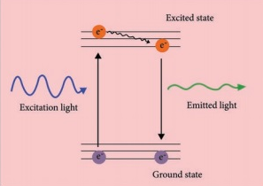
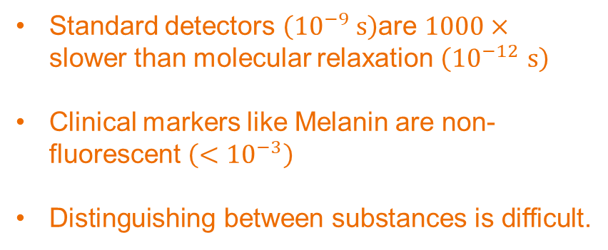
Background
Bottlenecks in Traditional Methods
Time: Capturing Molecular Dynamics
Space: Macroscopic 3D Imagine
Standard detectors $\left({10}^{−9} s\right)$are $1000×$ slower than molecular relaxation $\left({10}^{−12 }s\right)$
Clinical markers like Melanin are non-fluorescent $\left(<{10}^{−3}\right)$
Distinguishing between substances is difficult.
Traditional fundus cameras provide only 2D surface observation
High-NA lenses have a very shallow focal depth
Deep anatomical layers remain blurred under conventional optical methods
3

Slide 4
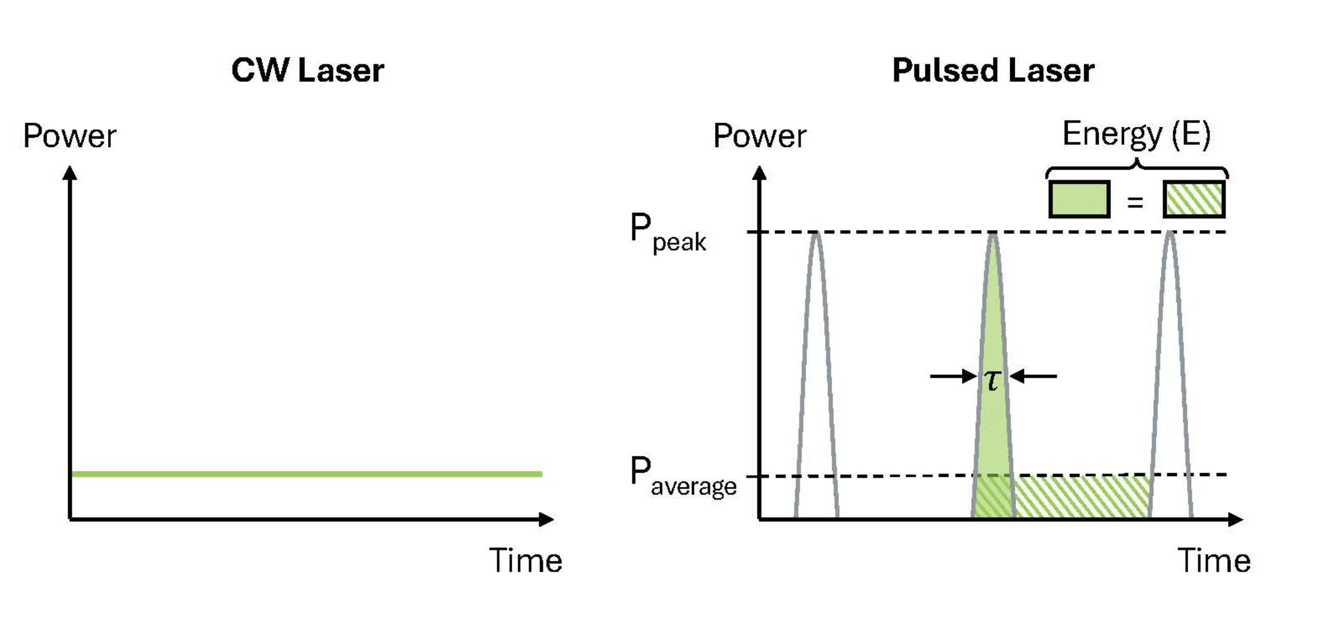
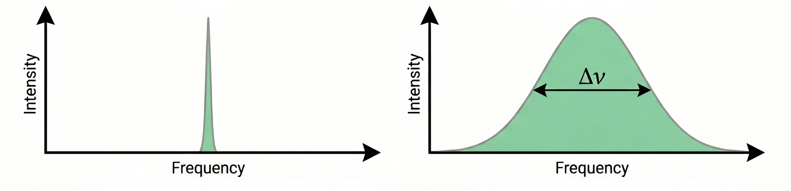
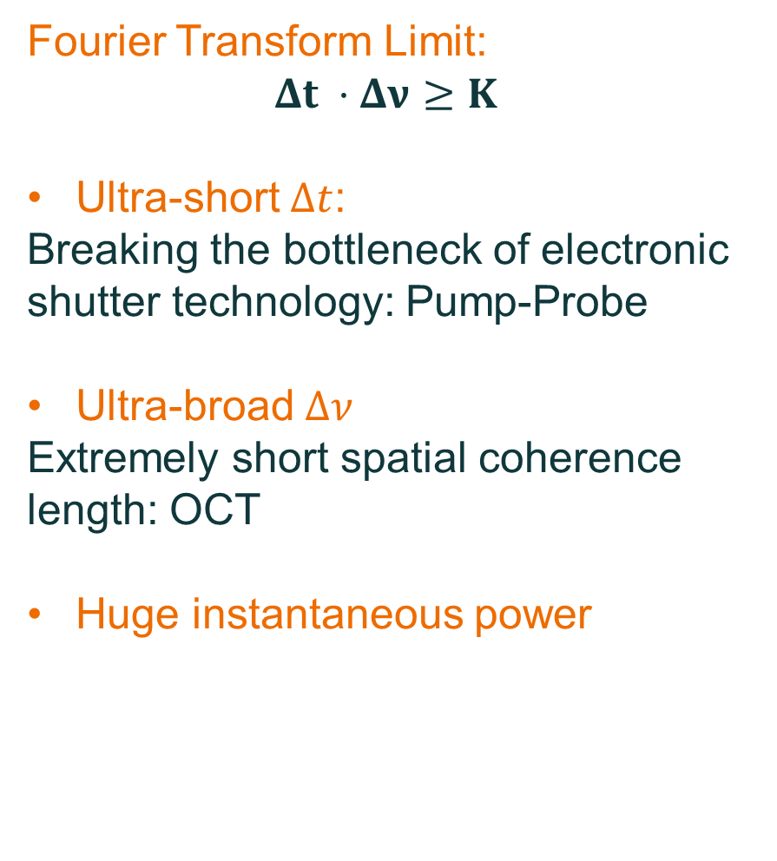
Background
Ultrafast Laser vs CW
Time and Frequency Differences
Fourier Transform Limit:
$$Δt ⋅Δν≥K$$
Ultra-short $Δt$:
Breaking the bottleneck of electronic shutter technology: Pump-Probe
Ultra-broad $Δν$
Extremely short spatial coherence length: OCT
Huge instantaneous power

Slide 5
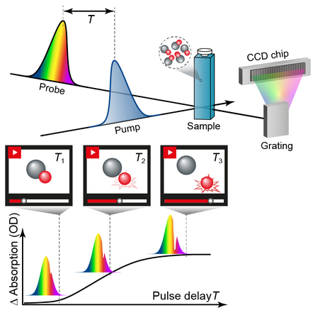
Temporal Resolution
Technical Principle
Time: Capturing Molecular Dynamics
Pump Pules: Using strong pulses to instantaneously induce excited states in molecules
Probe Pulse: The weak pulse arrives after a delay, and is responsible for "reading" the transient absorption change
5

Slide 6
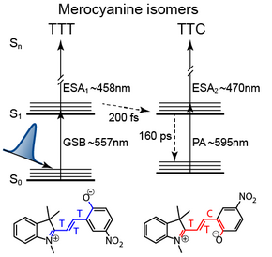
Temporal Resolution
Technical Principle in One Single Molecule
The transition of TTT and TTC
Ultrafast Transition: Captures the TTT to TTC conversion within 200 fs via coherent vibrational dynamics.
Full Relaxation: Tracks the final decay of the product back to the ground state over 160 ps.
The change of absorption Peak and Time information could be recorded by Probe.
Pump
J. Chem. Phys. 140, 244301 (2014)
6

Slide 7
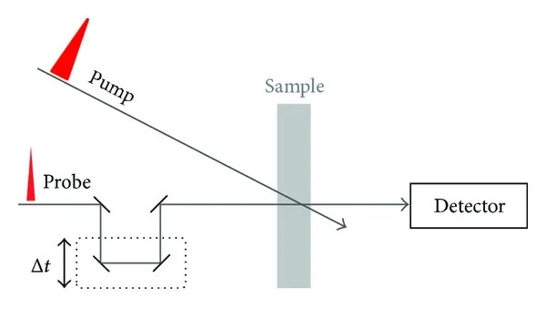
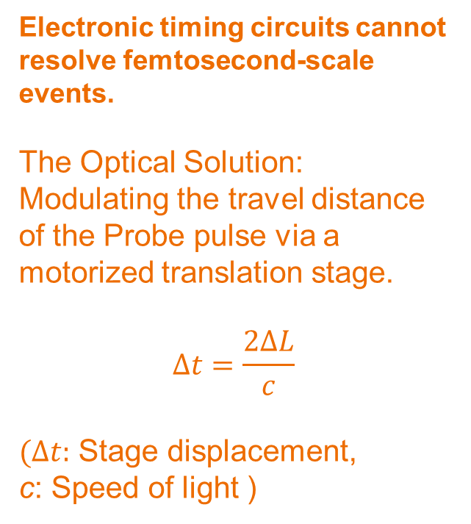
Temporal Resolution
Technical Principle in the Whole System
Changing The Time Delay
Electronic timing circuits cannot resolve femtosecond-scale events.
The Optical Solution: Modulating the travel distance of the Probe pulse via a motorized translation stage.
$$Δt=\frac{2ΔL}{c}$$
$(Δt:$ Stage displacement,
c: Speed of light )
L
7

Slide 8
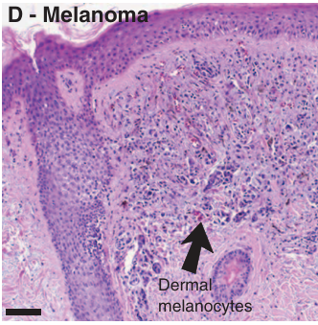
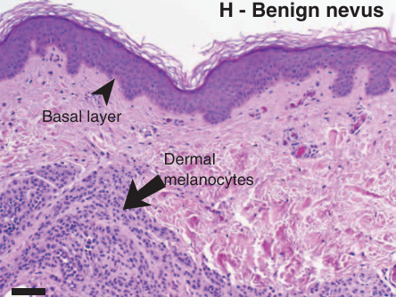
Temporal Resolution
The Diagnostic Dilemma of Traditional Histopathology
Malignant Melanoma (黑色素瘤) (Dermal melanocytes present)
Benign Nevus (黑色素痔) (Dermal melanocytes also present)
Both malignant and benign lesions can exhibit dermal melanocytes (真皮黑素细胞).
Lacking chemical contrast, pathologists must rely on subjective architectural evaluation, leading to high false-positive rates and 14% diagnostic discordance.
8
Sci. Transl. Med. 3, 71ra15 (2011)

Slide 9
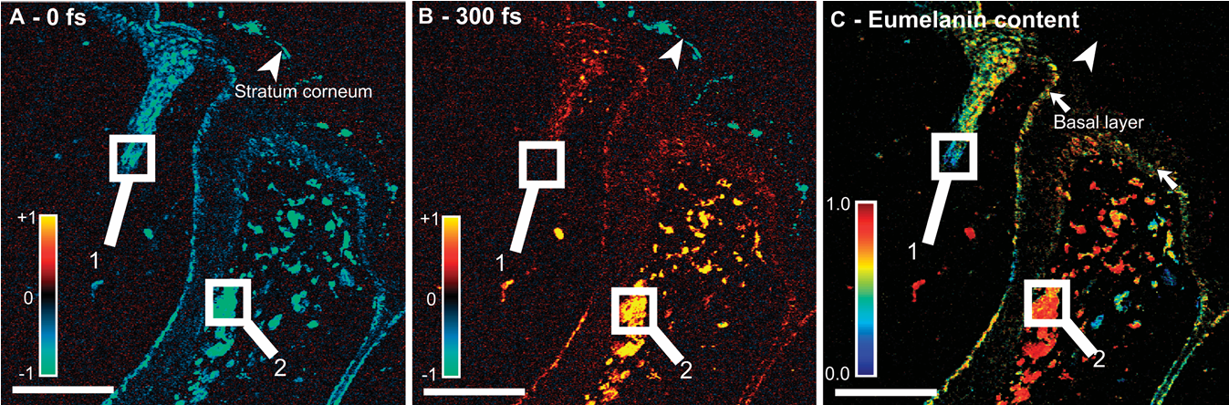
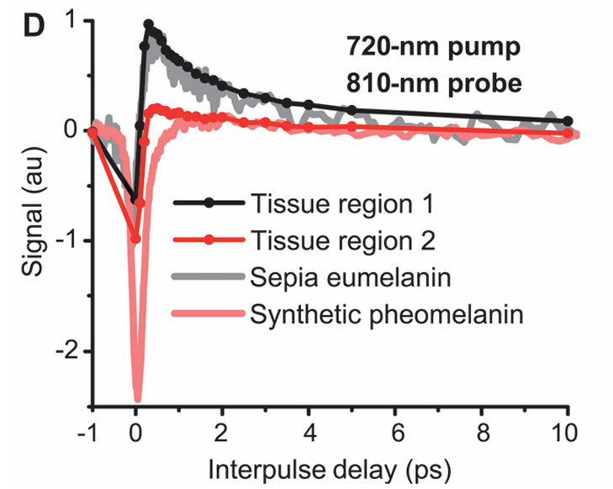
Temporal Resolution
Differentiating Melanoma (黑色素瘤) from Melanocytic Nevi (黑色素痔)
Pump-Probe Signals
The Baseline (0 fs): At zero delay, both melanins exhibit a negative signal (Ground-state depletion).
The Contrast Window (>300 fs):
Pheomelanin (褐黑素): Negative, extremely short-lived decay.
Eumelanin (真黑色素): Positive, long-lived excited-state absorption (ESA).
9
Sci. Transl. Med. 3, 71ra15 (2011)

Slide 10
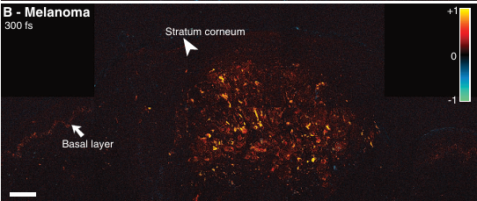
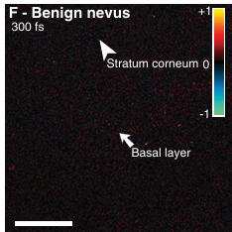
Temporal Resolution
Differentiating Melanoma (黑色素瘤) from Melanocytic Nevi (黑色素痔)
Pump-Probe Signals
Malignant Melanoma (恶性黑色素瘤): Demonstrates intense positive signals at 300 fs, indicating a high concentration of Eumelanin (真黑色素)
Benign Nevus (良性痣): Exhibits an absence of signal at 300 fs, confirming the lesion is almost entirely composed of Pheomelanin (褐黑素).
10
Sci. Transl. Med. 3, 71ra15 (2011)

Slide 11
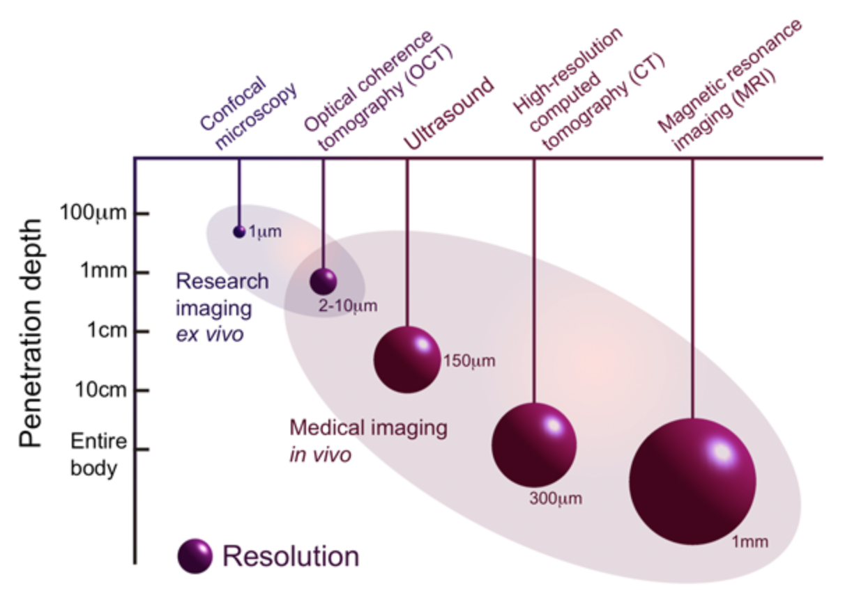
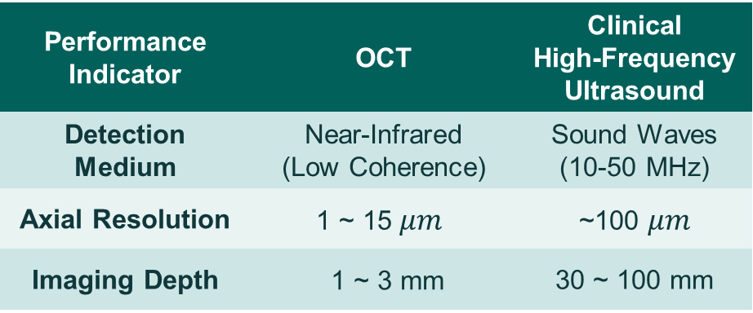
Spatial Resolution
OCT(Optical Coherence Tomography) vs. Ultrasound
OCT, often referred to as "optical ultrasound“, strikes a perfect balance between resolution and depth of penetration.
Performance Indicator | OCT | Clinical High-Frequency Ultrasound
Detection Medium | Near-Infrared (Low Coherence) | Sound Waves (10-50 MHz)
Axial Resolution | $$\text{1 \sim 15 }μm$$ | ~100 $μm$
Imaging Depth | 1 ~ 3 mm | 30 ~ 100 mm
High Resolution Imaging in Microscopy and Ophthalmology: New Frontiers in Biomedical Optics, edited by J. Roland, J. P. Rolland, and J. Jannick (Springer Nature, 2014).
11

Slide 12
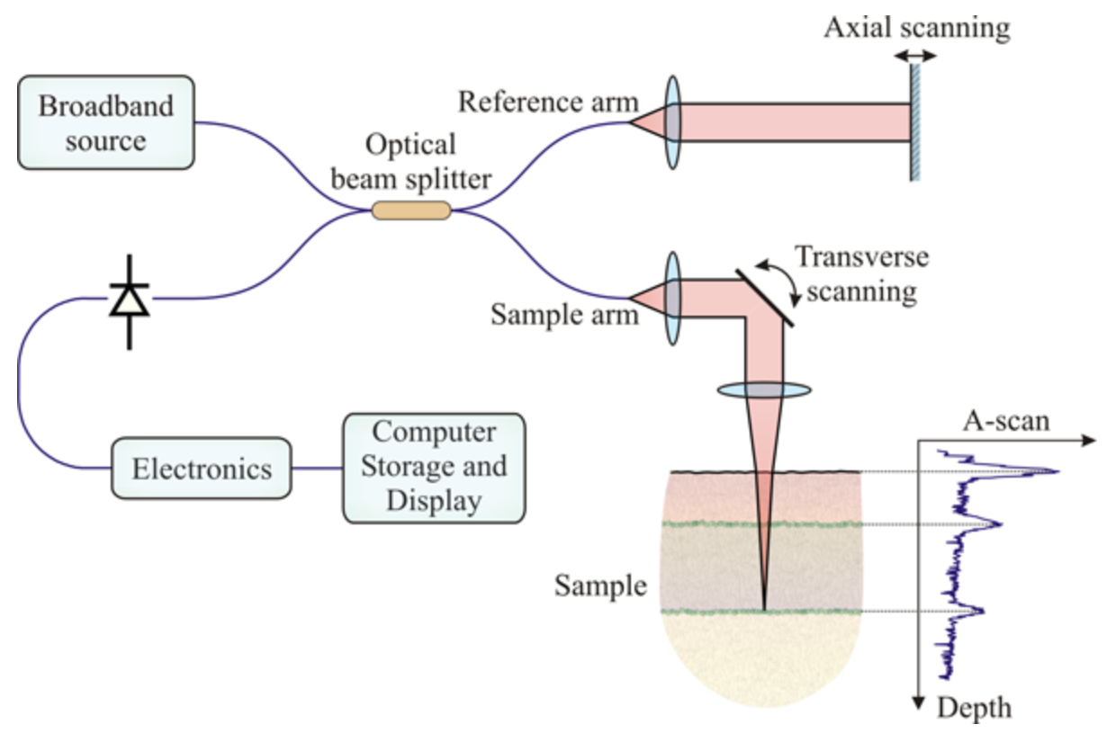


Spatial Resolution
OCT：Core Principle
Low-Coherence Interferometry
Axial Resolution
$$Δz=\frac{2\ln{2}}{π}\frac{λ_{0}^{2}}{Δλ}$$
(Wider bandwidth $Δλ→$ Higher resolution)
Advantages of Ultrafast Lasers:
According to the Fourier transform limit, a femtosecond pulse inherently possesses an extremely broad spectral bandwidth.
Low-coherence interferometry via a Michelson interferometer geometry
Interference occurs only when the optical path difference is strictly within the coherence length
12

Slide 13
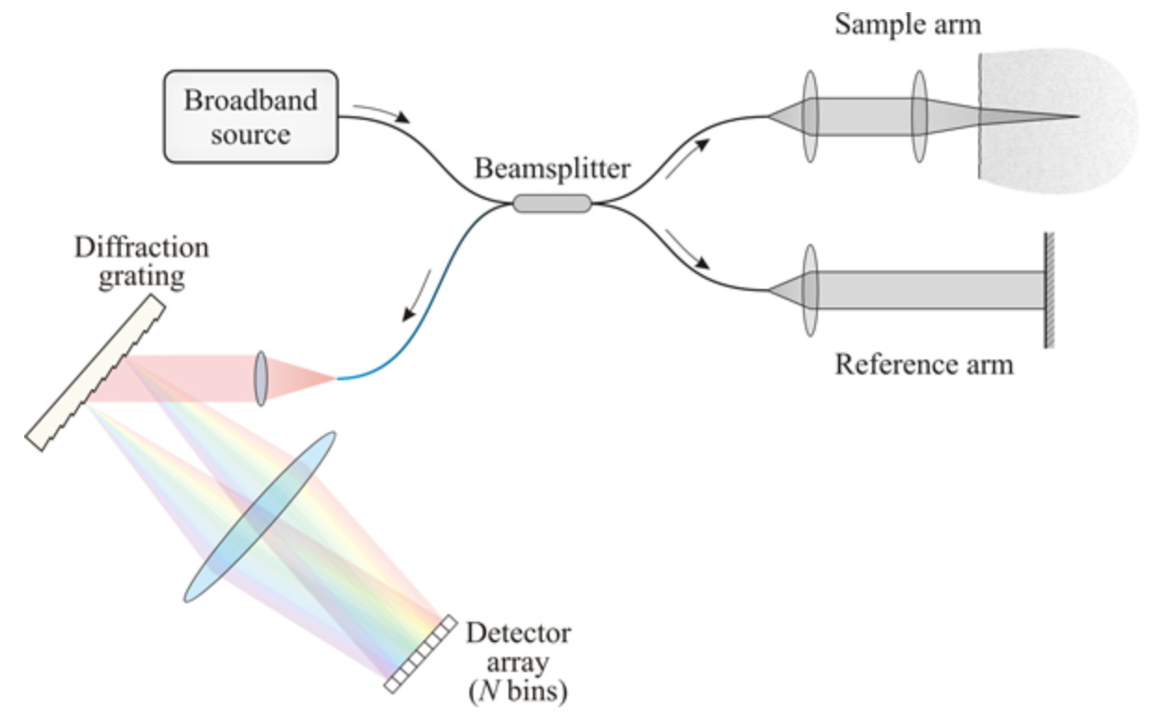
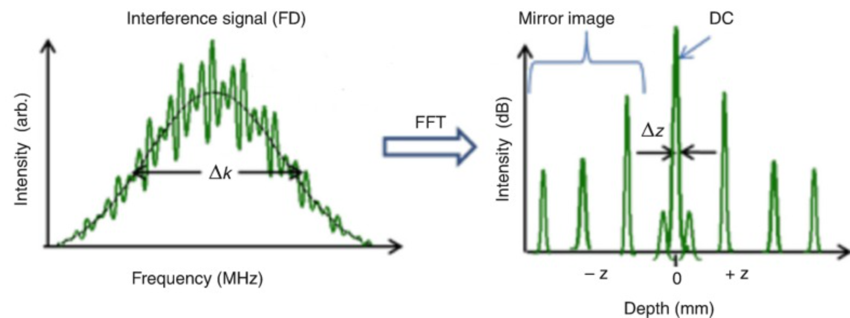
Spatial Resolution
OCT：Technical Evolution
SD-OCT：Spectral-Domain OCT
Coherent information from all depths is acquired in the frequency domain using a spectrometer
Eliminates mechanical reference arm scanning
Phase Stability
High Resolution Imaging in Microscopy and Ophthalmology: New Frontiers in Biomedical Optics, edited by J. Roland, J. P. Rolland, and J. Jannick (Springer Nature, 2014).
13

Slide 14
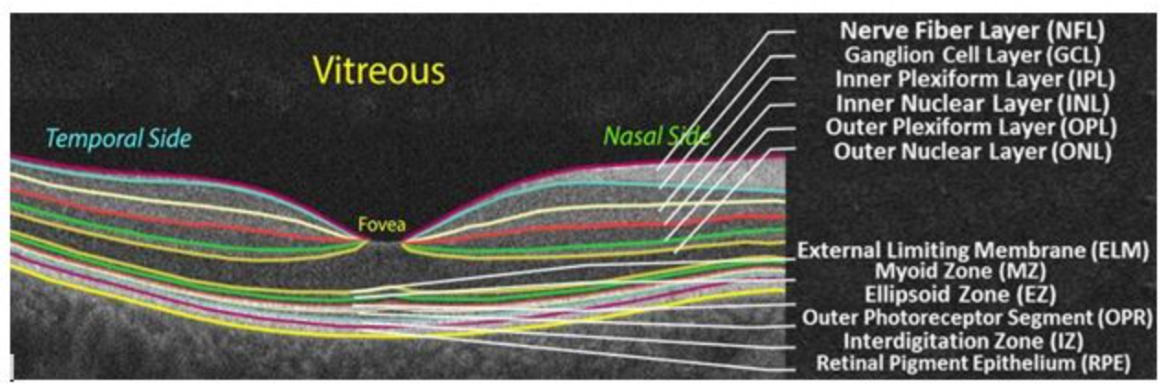
Spatial Resolution
OCT Applications：Structural imaging
Optical Biopsy of Retinal Layers
High-sensitivity resolution of stratified microstructures of the retina
using the ultra-broad spectrum of ultrafast lasers.
14

Slide 15
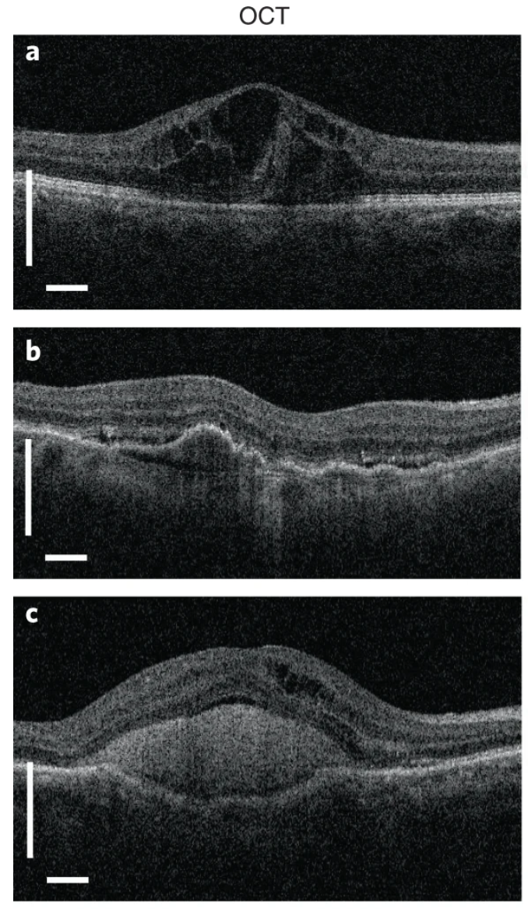
Spatial Resolution
OCT Applications：Structural imaging
Optical Biopsy of Retinal Layers
DME diagnosis: Real-time assessment of tissue fluid accumulation and cystic edema in areas such as the inner nuclear layer.
A patient with
diabetic macular edema
Drusen Identification: Precisely captures the minute bumps caused by the glass film light spot (Drusen) beneath the RPE layer.
A patient with choroidal neovascularization resulting from age-related macular degeneration (AMD)
Leakage monitoring: Observe the accumulation of subretinal high reflectivity material (SHRM), which is usually an important marker of choroidal neovascularization (CNV) and its activity.
A patient with neovascular
AMD with extensive subretinal hyperreflective material
C. De Fauw et al., Nat. Med. 24, 1342 (2018)
15

Slide 16
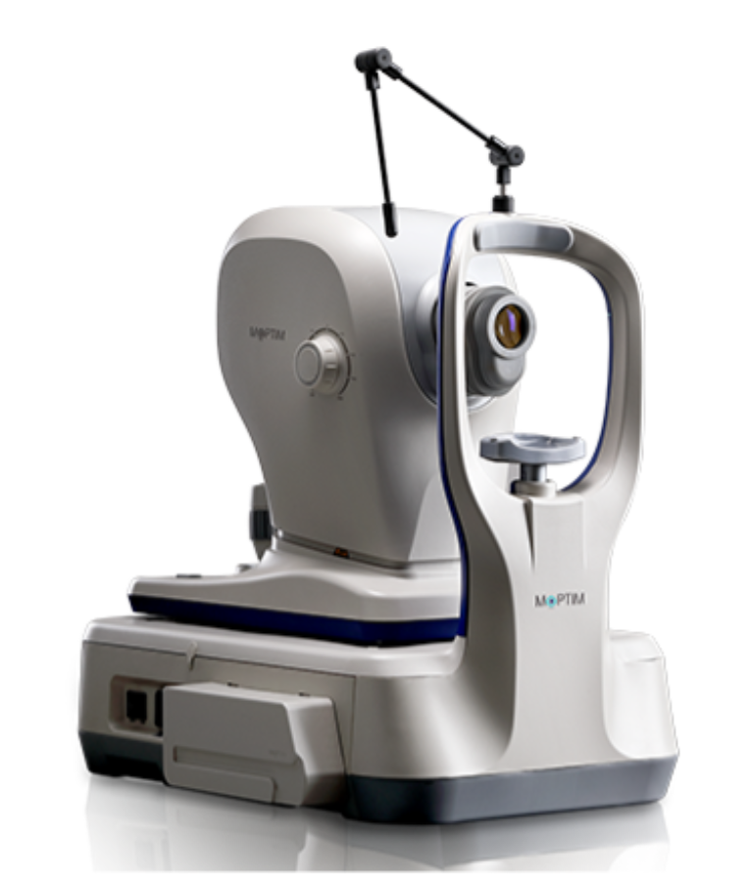
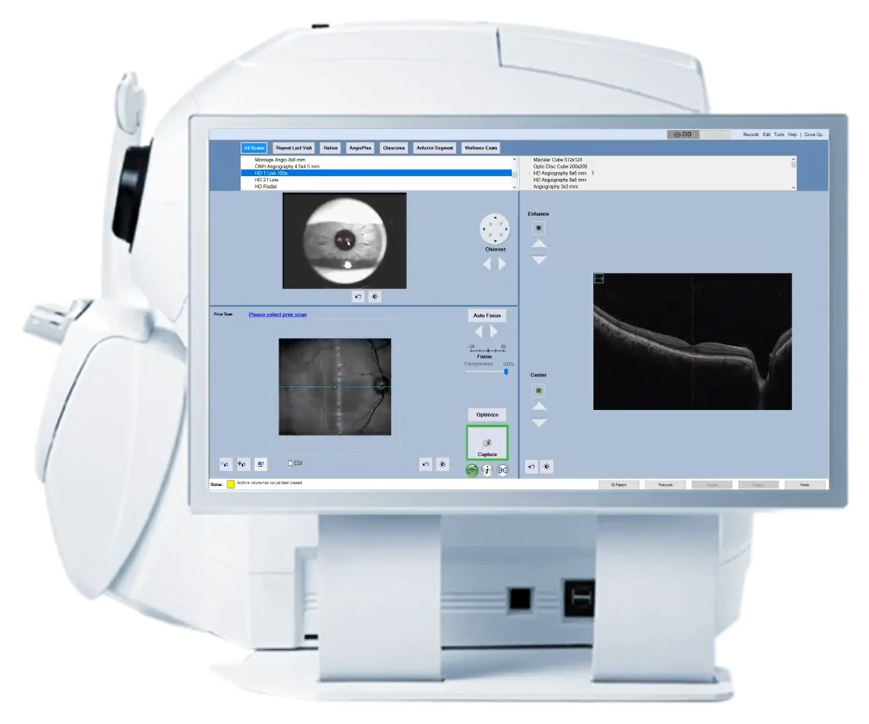
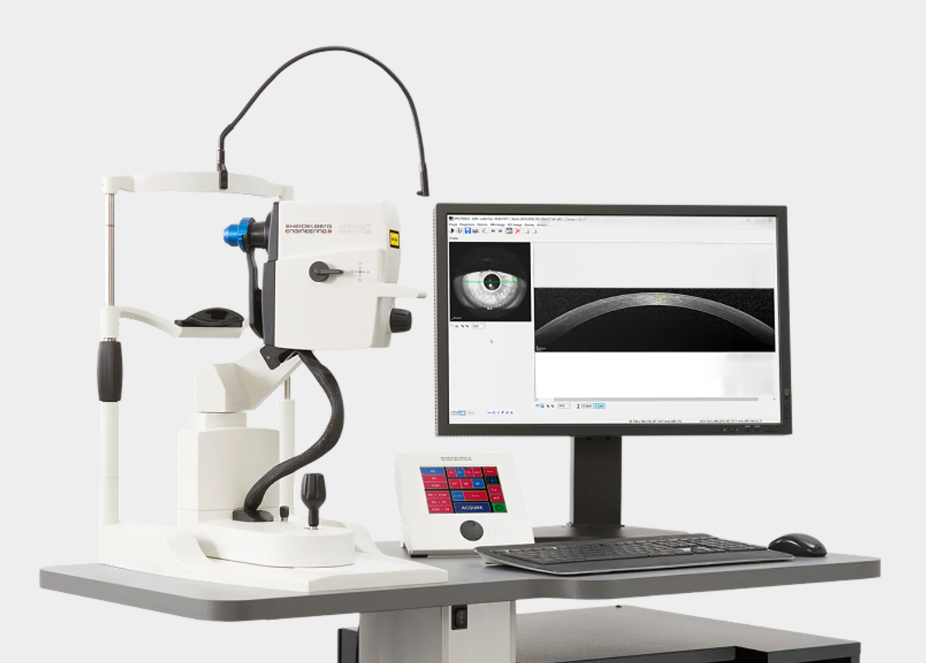
Spatial Resolution
OCT Applications：Commercialization
Zeiss Cirrus 5000
Heidelberg Spectralis
Mocean 4000
Successful market entry of OCT devices.
16

Slide 17

Conclusions
Diagnostic Science
Ultrafast laser technology is an important tool of modern label-free biomedical diagnostics.
Temporal Domain: Transient Dynamics
The Pump-Probe method turns spatial distance into high time resolution. It helps us capture the fast process of heat loss at the molecular level.
Spatial Domain: 3D Anatomy
OCT uses the features of ultrafast lasers to produce 3D images with extremely high resolution. Unlike traditional tools, it can show deep details clearly without touching the body.
Future
The combination of deep learning and functional OCT/Pump-Probe will provide a new imaging tool. It will further improve the quality of medical pictures and offer more help in clinical medicine.
17

Slide 18
References
[1] H.A. Haus, Mode-locking of lasers, IEEE Journal of Selected Topics in Quantum Electronics 6(6) (2000) 1173-1185.https://doi.org/10.1109/2944.902165
[2] A.H. Zewail, Femtochemistry: Atomic-Scale Dynamics of the Chemical Bond, The Journal of Physical Chemistry A 104(24) (2000) 5660-5694.https://doi.org/10.1021/jp001460h
[3] D. Huang, E.A. Swanson, C.P. Lin, J.S. Schuman, W.G. Stinson, W. Chang, M.R. Hee, T. Flotte, K. Gregory, C.A. Puliafito, J.G. Fujimoto, Optical Coherence Tomography, Science 254(5035) (1991) 1178-1181.https://doi.org/doi:10.1126/science.1957169
[4] I.R. Piletic, T.E. Matthews, W.S. Warren, Probing Near-Infrared Photorelaxation Pathways in Eumelanins and Pheomelanins, The Journal of Physical Chemistry A 114(43) (2010) 11483-11491.https://doi.org/10.1021/jp103608d
[5] W. Min, S. Lu, S. Chong, R. Roy, G.R. Holtom, X.S. Xie, Imaging chromophores with undetectable fluorescence by stimulated emission microscopy, Nature 461(7267) (2009) 1105-1109.https://doi.org/10.1038/nature08438
[6] T.E. Matthews, I.R. Piletic, M.A. Selim, M.J. Simpson, W.S. Warren, Pump-probe imaging differentiates melanoma from melanocytic nevi, Sci Transl Med 3(71) (2011) 71ra15.https://doi.org/10.1126/scitranslmed.3001604
[7] N. Nishizawa, Wideband ultrafast fiber laser sources for OCT and metrology, Journal of Physics B: Atomic, Molecular and Optical Physics 49(18) (2016) 182003.https://doi.org/10.1088/0953-4075/49/18/182003
[8] P. Chen, Z. Long, Q. Cheng, M. Song, W. Wang, R. Liu, Z. Zhang, K. Xia, Z. Yang, L. Qian, S. Bai, X. Wang, P. Yang, P. Xu, E.S. Yousef, R. Wang, On-Chip Supercontinuum Generation Pumped by Short Wavelength Fiber Lasers, Photonics, 2024, p. 440.10.3390/photonics11050440.
18

Slide 19

THANKS FOR ATTENTION！

